Slide 1
BUILD PRO -BUILDING ESTIMATION TRACKER SYSTEM
Department of MCA, MES College of Engineering , Kuttippuram
25th october2023
PREPARED BY
AARATHY P S (MES22MCA-2001)
PTEMBER 2022

Slide 2
GUIDED BY
PROF. HYDERALI K
ASSISTANT PROFESSOR
MASTER OF COMPUTER APPLICATIONS
MES COLLEGE OF ENGINEERING , KUTTIPPURAM

Slide 3
CONTENTS:-
Introduction
Modules
Product Backlog
Project Plan
Sprint
Data Flow Diagram

Slide 4
INTRODUCTION:-
Advanced cost estimation system for building construction (Build Pro) is a very useful application for common people who are zero level to intermediate level knowledge on building construction and cost estimation calculation.
To some extend even a building contractor also use this application for calculating the cost for developing a new house or a building accurately.
The final cost estimation result will give the estimated cost of the materials used for build a house or building.
Using the proposed application each user can create as many as building or home that they wanted to find out the estimated building cost.
The major purpose of BUILD PRO is to implement the computerization of estimation in building construction. The users can easily find their rate that is required for constructing a building. The website has a user-friendly environment, that everyone can use it easily.
Also, it provides the user from fake estimation rates given by the contractors. There will be an administrative section, the role of administrator is configuring the expense for each material, and for each material there will be a cost range.
This will help the user to get an idea of total cost variation by using priced materials. And also administrator will manage the basic building materials like sand, cement, metal chips, iron bar etc.
The role of the user to select the material needed to build the house or building.when the user doesnot know the materials the user have the option to gave the sq.ft of the building ,then the user can show the material needed to build his house and the estimation cost.

Slide 5
Modules:-
1.ADMIN:-
* Login
*Add items and cost
*Mange items and their cost
*Upload items image
2.USER
* Register
* Login
* View the materials used for building construction
* Selection of essential materials needed to building construction
*View User Profile
*Edit User Profile
*Enter the sq.ft of Building
*View material and Estimation cost
3.COST ESTIMATION
Construction cost Estimation

Slide 6
HARDWARE SPECIFICATION: - Processor : i3 or above Speed : 2.2 GHz Hard Disk : 1 TB Key Board : standard Window key Board RAM :2GB SOFTWARE SPECIFICATION:- OS : Os independent (javascript runtime) Front End : React JS,css Back End : Node.js Database : MongoDB IDE : visual studio code

Slide 7
Product Plan
ID | TASK NAME | START DATE | END DATE | PROJECT HOURS | STATUS
1 | Sprint 1 | 15/09/2023 | 12/10/2023 | 13 | Planned
2 | Sprint 2 | 13/10/2023 | 03/11/2023 | 14 | Planned
3 | Sprint 3 | 08/11/2023 | 30/11/2023 | 14 | Planned

Slide 8
Product Backlog
ID | PRIORITY | SIZE (Hours) | SPRINT | STATUS | NAME
1 | Medium | 8 | 1 | Planned | Registration
2 | Medium | 4 |  | Planned | Login
3 | High | 10 | 2 | Planned | Table Design
4 | High | 9 |  | Planned | Coding
5 | Medium | 4 | 3 | Planned | Testing data
6 | High | 6 |  | Planned | Output generation

Slide 9
USER STORY
UserStory ID | As a <type of user> | I want to | So that I can
1 | Admin | Login | Login successful with correct Username and password
2 | Admin | Add item | Add the materials required to build a building
3 | Admin | Manage Registered user | Manage the Registered user
4 | Admin | View Registered User | View the users
5 | Admin | Upload item images | Upload the items images
6 | Admin | Add item cost | Add the materials coset
7 | Admin | Manage items | Edit/remove the items
8 | User | Register | New user login with name, email and password
9 | User | Login | Login successful with correct Username and password

Slide 10
User story id | AS a <type of user> | I want to | So that I can
11 | User | View the materials | User can view the materials name,image and price
12 | User | Select the material | User can select the materials needed to build their building
13 | User | View user profile | View the profile
14 | User | Edit user profile | Edit,change password
15 | User | Upload the sq.ft | User can upload the sq.ft of building
16 | user | Cost Estimation | View the Estimation cost

Slide 11
Project Plan
User Story ID | Sprint | Start Date | End Date | Days | Status
1 , 2 , 3 , 9 , 10 , 11 | Sprint 1 | 15/09/23 | 29/09/23 | 14 | Planned
12 , 13 |  | 30/09/23 | 12/10/23 | 13 | Planned
14 , 4 | Sprint 2 | 13/10/23 | 29/10/23 | 16 | Planned
5 , 14 , 15 | Sprint 4 | 30/10/23 | 3/11/23 | 4 | Planned
6 , 7 ,8,16 | Sprint 3 | 8/11/23 | 30/11/23 | 22 | Planned

Slide 12
Sprint plan Sprint:1
Backlog Item | Status and Completion date | Original Estimate in hours | Day 1 15/09 | Day 2 20/09 | Day 3 21/09 | Day 4 28/09 | Day 5 29/09 | Day 6 04/10 | Day 7 05/10 | Day 8 06/10 | Day 9 11/10 | Day 10 12/10
Form Design | 15/09/2023 | 2 | 2 | 0 | 0 | 0 | 0 | 0 | 0 | 0 | 0 | 0
Table Design | 28/09/2023 | 3 | 0 | 1 | 1 | 1 | 0 | 0 | 0 | 0 | 0 | 0
Coding | 06/10/2023 | 6 | 0 | 0 | 0 | 0 | 2 | 1 | 1 | 2 | 0 | 0
Testing & Validation | 12/10/2023 | 2 | 0 | 0 | 0 | 0 | 0 | 0 | 0 | 0 | 1 | 1
Total |  | 13 | 2 | 1 | 1 | 1 | 2 | 1 | 1 | 2 | 1 | 1

Slide 13
Sprint 2:-
Backlog Item | Status and Completion date | Original Estimate in hours | Day 1 13/10 | Day 2 18/10 | Day 3 19/10 | Day 4 20/10 | Day 5 25/10 | Day 6 26/10 | Day 7 27/10 | Day 8 01/11 | Day 9 02/11 | Day 10 03/11
Form Design | 13/10/2023 | 2 | 2 | 0 | 0 | 0 | 0 | 0 | 0 | 0 | 0 | 0
Table Design | 18/10/2023 | 1 | 0 | 1 | 0 | 0 | 0 | 0 | 0 | 0 | 0 | 0
Coding | 01/11/2023 | 8 | 0 | 0 | 1 | 2 | 1 | 1 | 2 | 1 | 0 | 0
Testing & Validation | 03/11/2023 | 3 | 0 | 0 | 0 | 0 | 0 | 0 | 0 | 0 | 1 | 2
Total |  | 14 | 2 | 1 | 1 | 2 | 1 | 1 | 2 | 1 | 1 | 2

Slide 14
Sprint 3:-
Backlog Item | Status and Completion date | Original Estimate in hours | Day 1 08/11 | Day 2 09/11 | Day 3 10/11 | Day 4 15/11 | Day 5 16/11 | Day 6 17/11 | Day 7 22/11 | Day 8 23/11 | Day 9 24/11 | Day 10 29/11 | Day 11 30/11
Coding | 22/11/2023 | 9 | 1 | 1 | 2 | 1 | 1 | 2 | 1 | 0 | 0 | 0 | 0
Testing & Validation | 30/11/2023 | 5 | 0 | 0 | 0 | 0 | 0 | 0 | 0 | 1 | 2 | 1 | 1
Total |  | 14 | 1 | 1 | 2 | 1 | 1 | 2 | 1 | 1 | 2 | 1 | 1

Slide 15
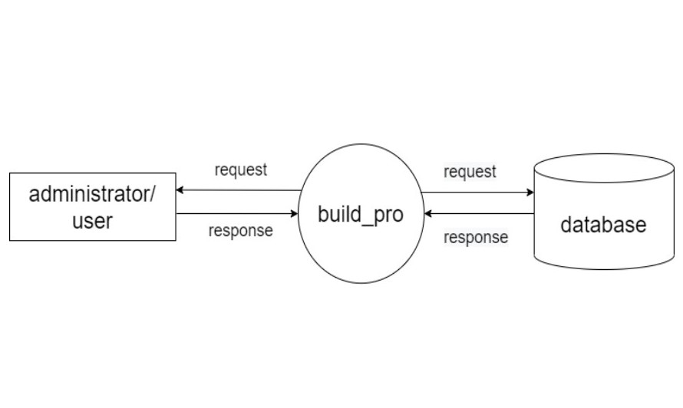
DATA FLOW DIAGRAM:-
LEVEL 0:-

Slide 16
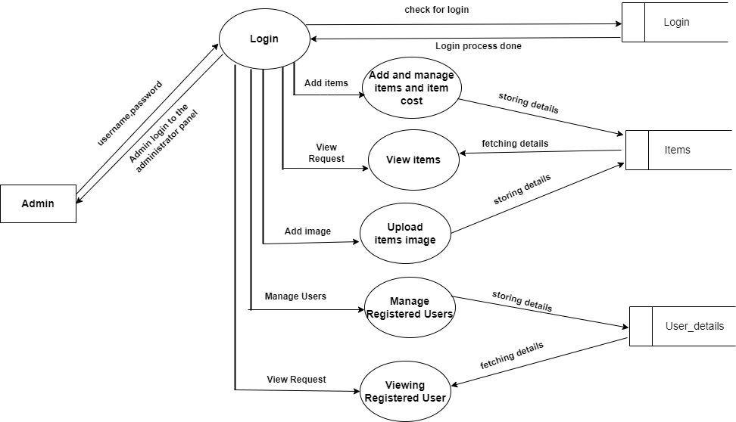
Level 1:-

Slide 17
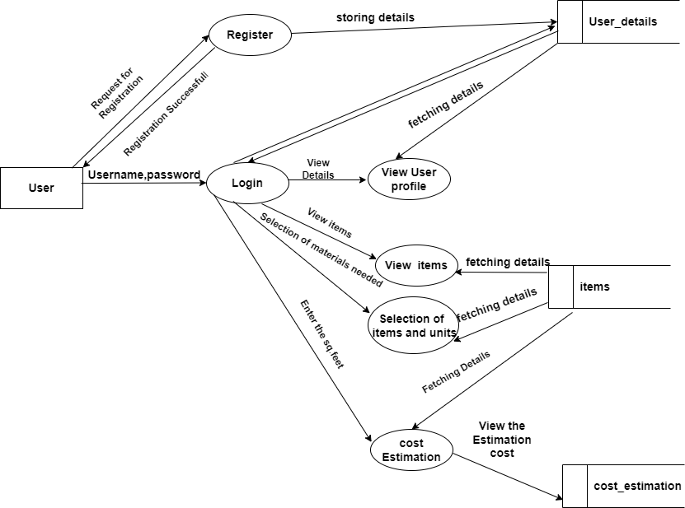
Level 2:-

